Slide 1
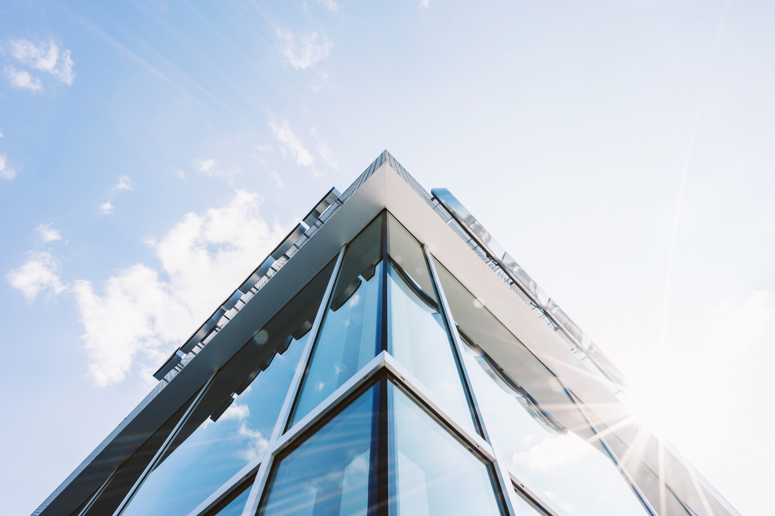


COMPANY
PROFILE
Presentation
Wadi Amreesh General Contracting & Real Estate Investment Joint-Stock Company
تأسست سنة 2007 – سرت / طرابلس – ليبيا
00218912180906 📞|
📧Atbekatarek@gmail.com

Slide 2
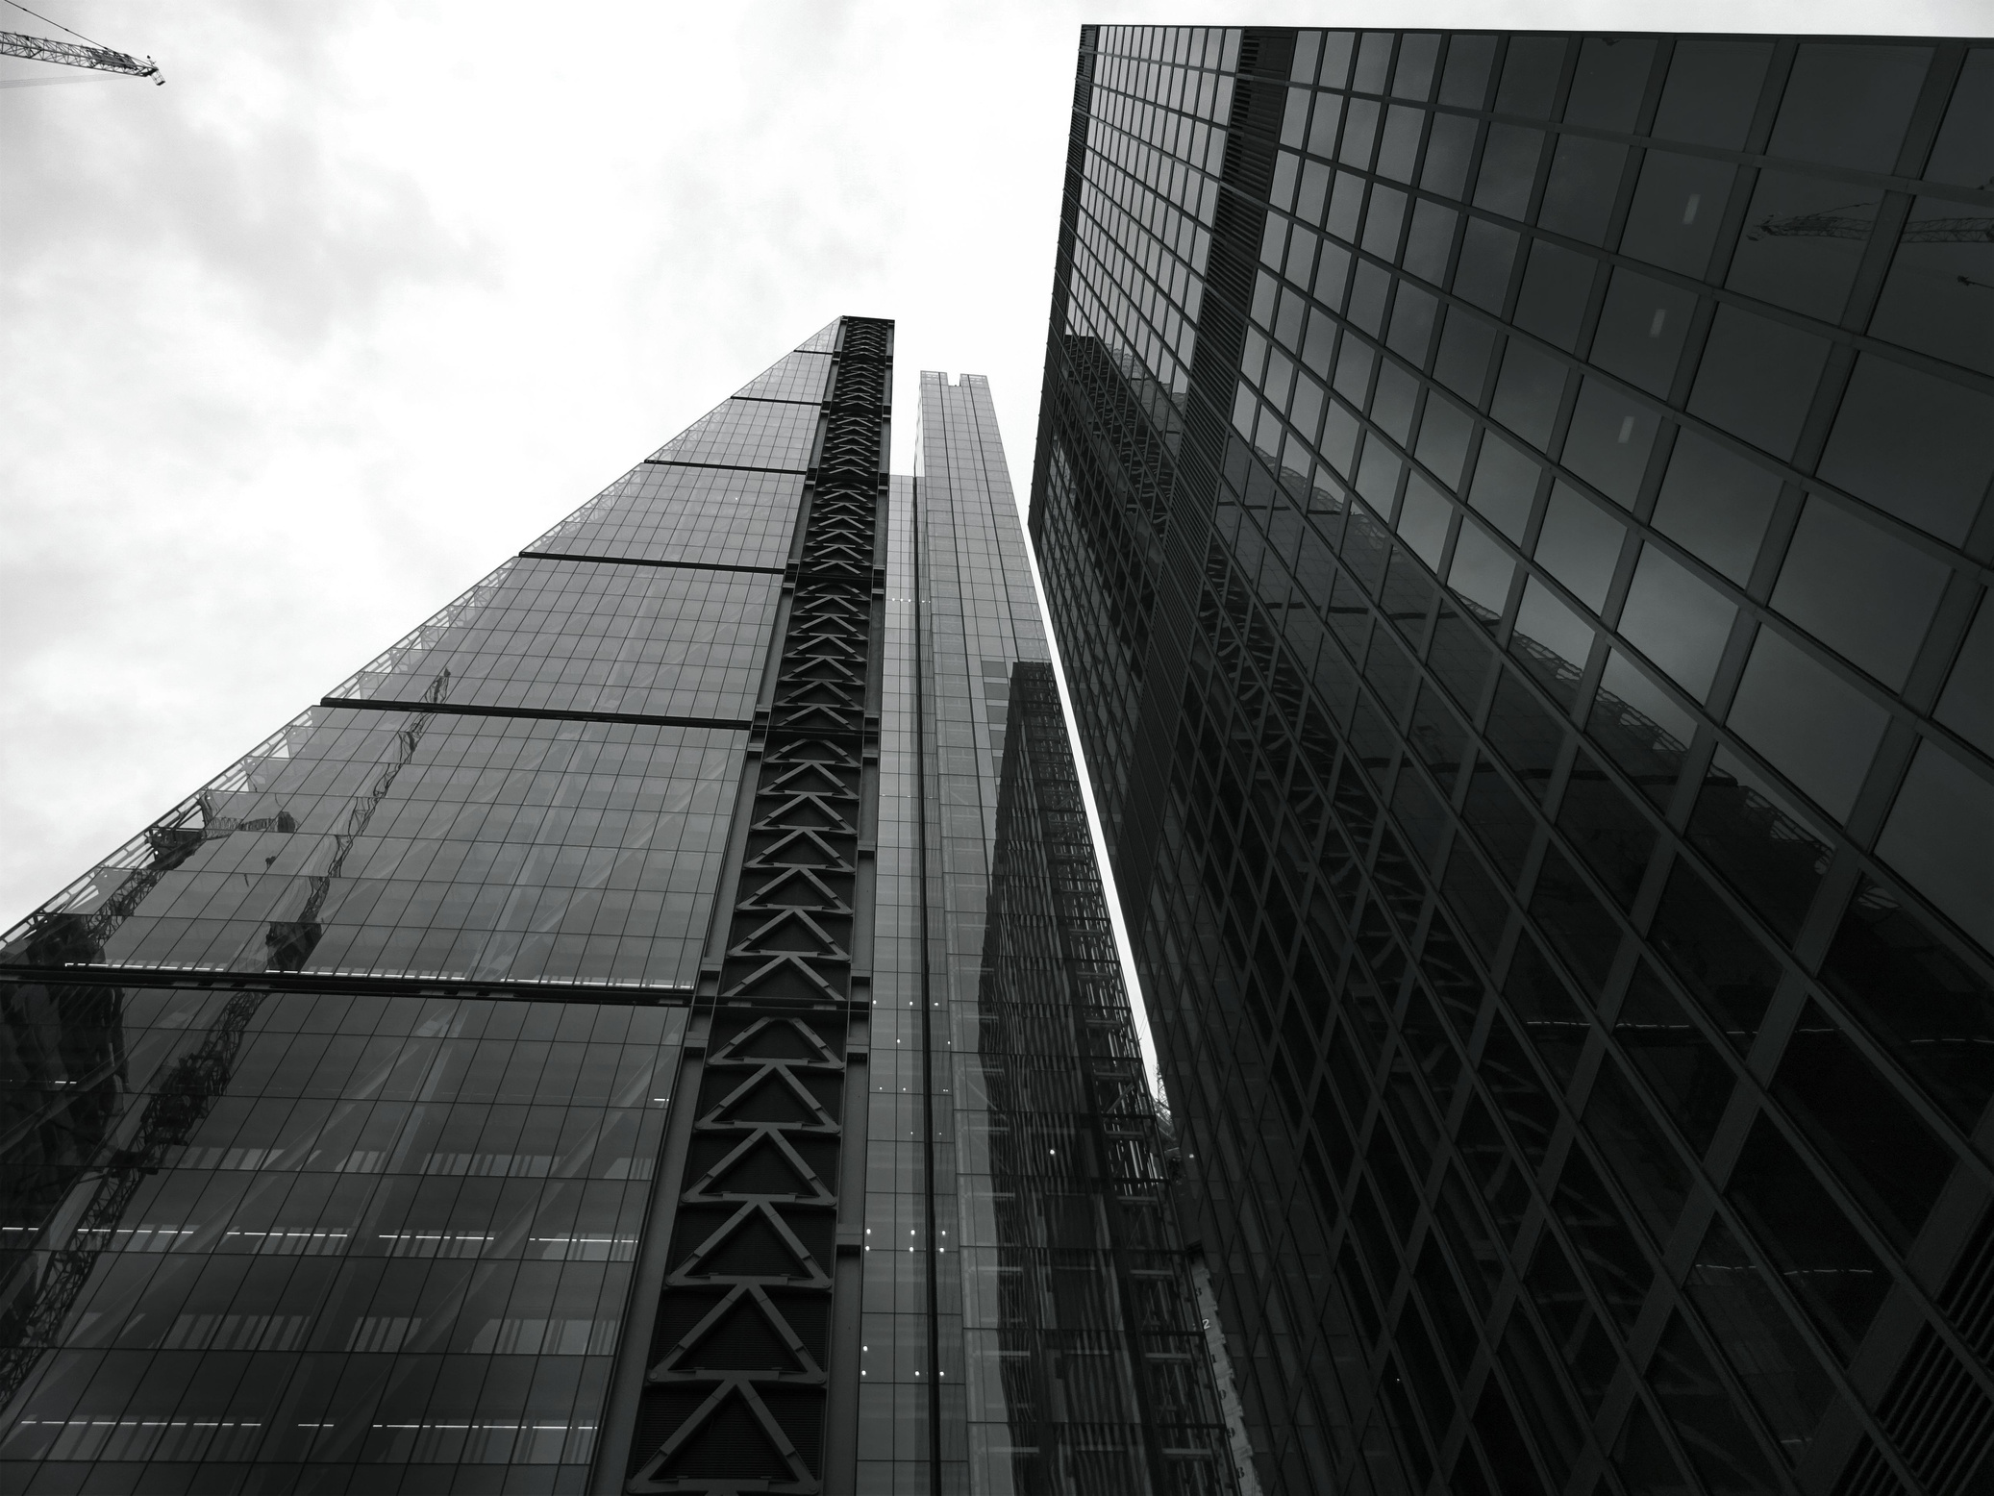
ABOUT OUR
COMPANY
Wadi Amreesh General Contracting & Real Estate Investment Joint-Stock Company is one of Libya’s leading companies in the field of general contracting and real estate development. Founded in 2007 in the city of Sirte, the company has expanded its operations to several regions across Libya, including Tripoli. It is distinguished by its commitment to delivering high-quality projects with the highest standards of safety and professionalism.
.

Slide 3
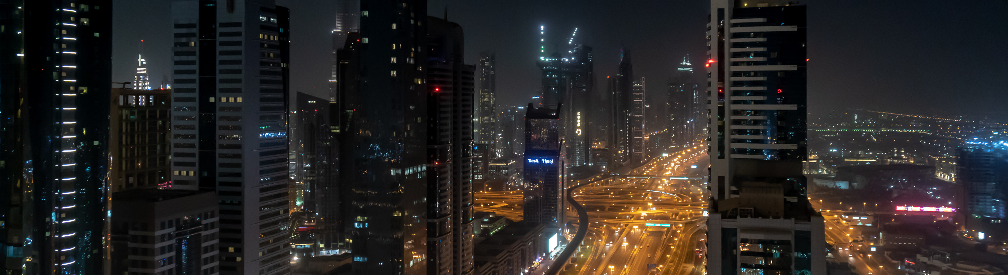
VISION &
MISSION
Vision
Mission
To be a pioneer in providing innovative engineering and construction solutions that contribute to building a sustainable and prosperous future in Libya.
To deliver projects with integrity and quality, ensuring a safe working environment and enhancing efficiency and professionalism at all levels.
.

Slide 4
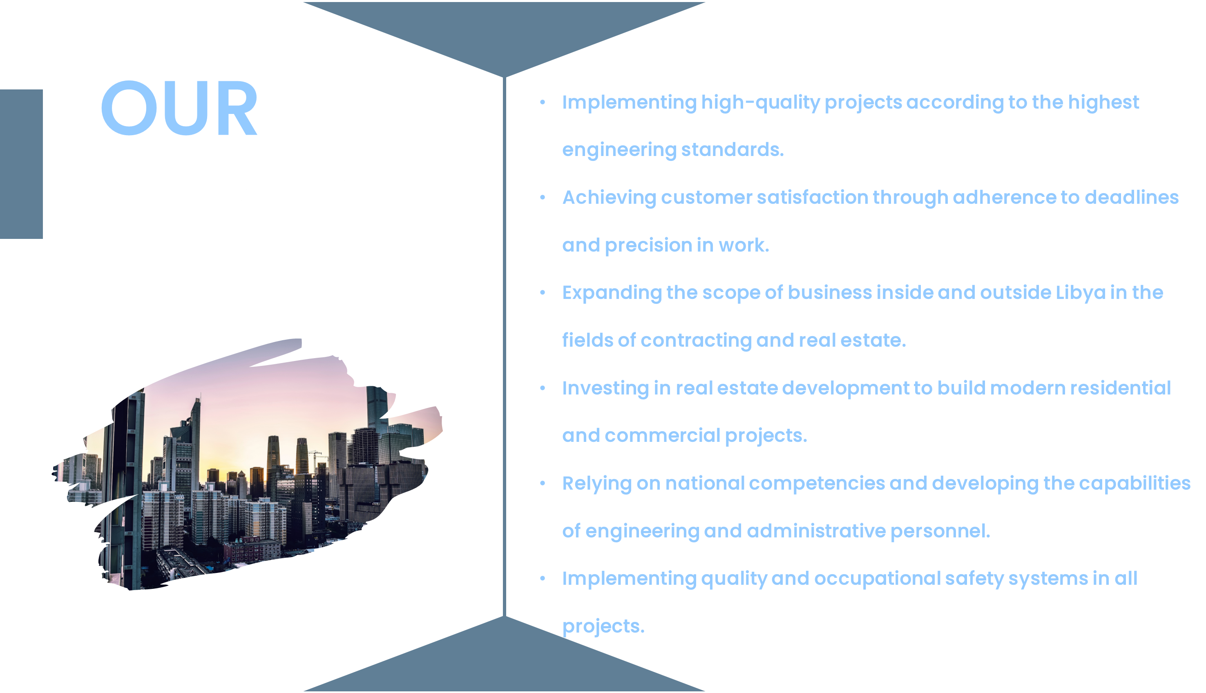

Slide 5
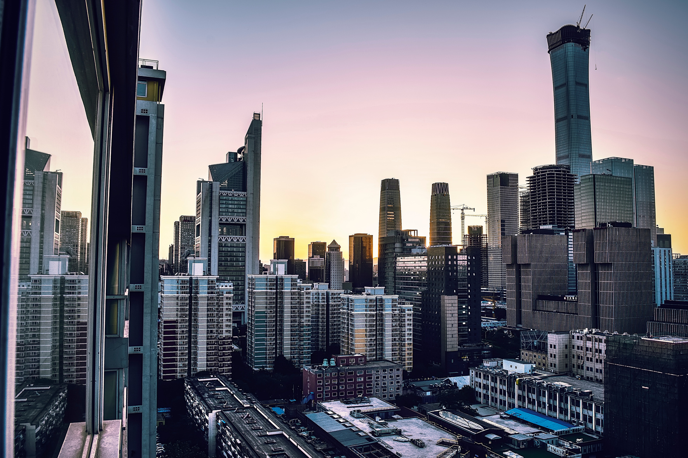
Completed Projects
• Execution of sewage lines for the Infrastructure Project – Phase I.
• Execution of sidewalks and sewage lines for the Infrastructure Project – Phase II.
• Water supply works for the 52 Ministerial Villas Project.
• Construction of 100 housing units in Umm Al-Qandeel.
• Construction of 18 housing units with infrastructure in Sirte City.
• Construction of 20 housing units in Sirte City.
• Maintenance of Sirte Public Stadium – concrete repair and facility preparation.
• Construction of the Transport Department hangar at Sirte University.
• Maintenance of the Libyan Intelligence Building.
• Maintenance of the 66 kV Station in Jarif Area.
• Maintenance of the Major Consumers Building.
• Construction of the rear access road to Sirte University.
• Construction of a school in Wadi Al-Mardum.
• Maintenance of the utilities station at Ras Lanuf Plant.
• Maintenance of the tank at Ras Lanuf Station.
.

Slide 6
BUSINESS
www.reallygreatsite.com
PLAN
Objectives: To implement high-quality residential and commercial projects.Gradual expansion in the local and then regional markets.
Services: General contracting, real estate development, maintenance, and operation.
Structure: General management, projects, finance, marketing, and technical support.
Financing: Founders' capital + bank financing + project profits.Excellence: Commitment, quality, transparency, and customer satisfaction

Slide 7


MARKETING
Digital Marketing
STRATEGY
Using online platforms such as the official website and social media to showcase ongoing and completed projects and share the company's success stories.
Relationships and Partnerships
Wadi Marish Contracting and Real Estate Investment Company's marketing strategy is based on several key axes aimed at strengthening its position in the market and attracting clients and investors. Its most prominent elements include
Establishing strategic partnerships with government agencies and real estate developers to expand the scope of projects.
Field Advertising
Using billboards at project sites and vital areas to attract potential customers.
Identity and Branding:
Building a professional image that reflects quality and commitment to project implementation, while highlighting the values ​​of trust and precision.
Customer Service:
Developing an effective follow-up and response system to build long-term relationships with customers and investors.

Slide 8
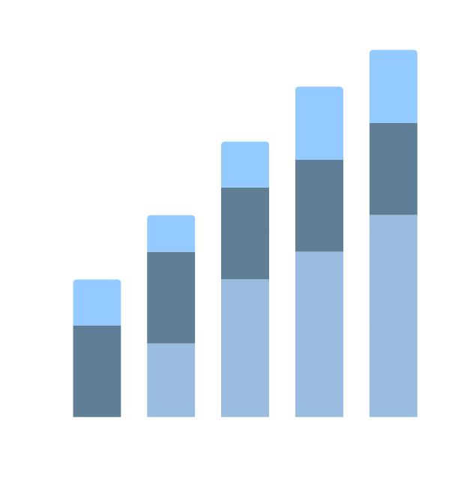




COMPANY
OVERVIEW
Wadi Amreesh Contracting and Real Estate Investment Company is a general construction and real estate development company.
customer satisfaction Wadi Amreesh embraces a vision of leadership in the contracting sector through its commitment to high quality, the use of the latest construction technologies, and
.
company focuses on providing integrated engineering solutions, including construction, design, project management, and investment in residential and commercial properties
The company also prioritizes sustainability and developing a professional work environment that combines efficiency and innovation

Slide 9


MEET OUR
TEAM
Executive Director:
Engineer Tariq Mustafa Abdullah
We are professionals providing today’s digital marketing and advertising services.
Engineering Design and Supervision Department
Engineering Design and Supervision Department
Director of Administrative and Financial Management:
Technical Director
Engineer Ahmed Abdullah
Engineer Hakima Khalifa
Engineer Khawla Imraj
Hussein Khalifa Hussein

Slide 10

FUTURE
PLANS
🏗️
First: Expanding Projects
💰 Second: Financial and Administrative Development
🌿 Third: Quality and Sustainability
👷‍♂️ Fourth: Human Resources Development
📱 Fifth: Marketing and Identity
🌍 Sixth: Future Investments

Slide 11




THANK
We look forward to working with you
YOU
Contact Us
📞 00218912180906
📧 Atbekatarek@gmail.com
Headquarters: Sirte, Libya
🏢 Branch: Tripoli, Libya

